Slide 1
MimicMol: The Vision
Austin Yang / yanglers

Slide 2
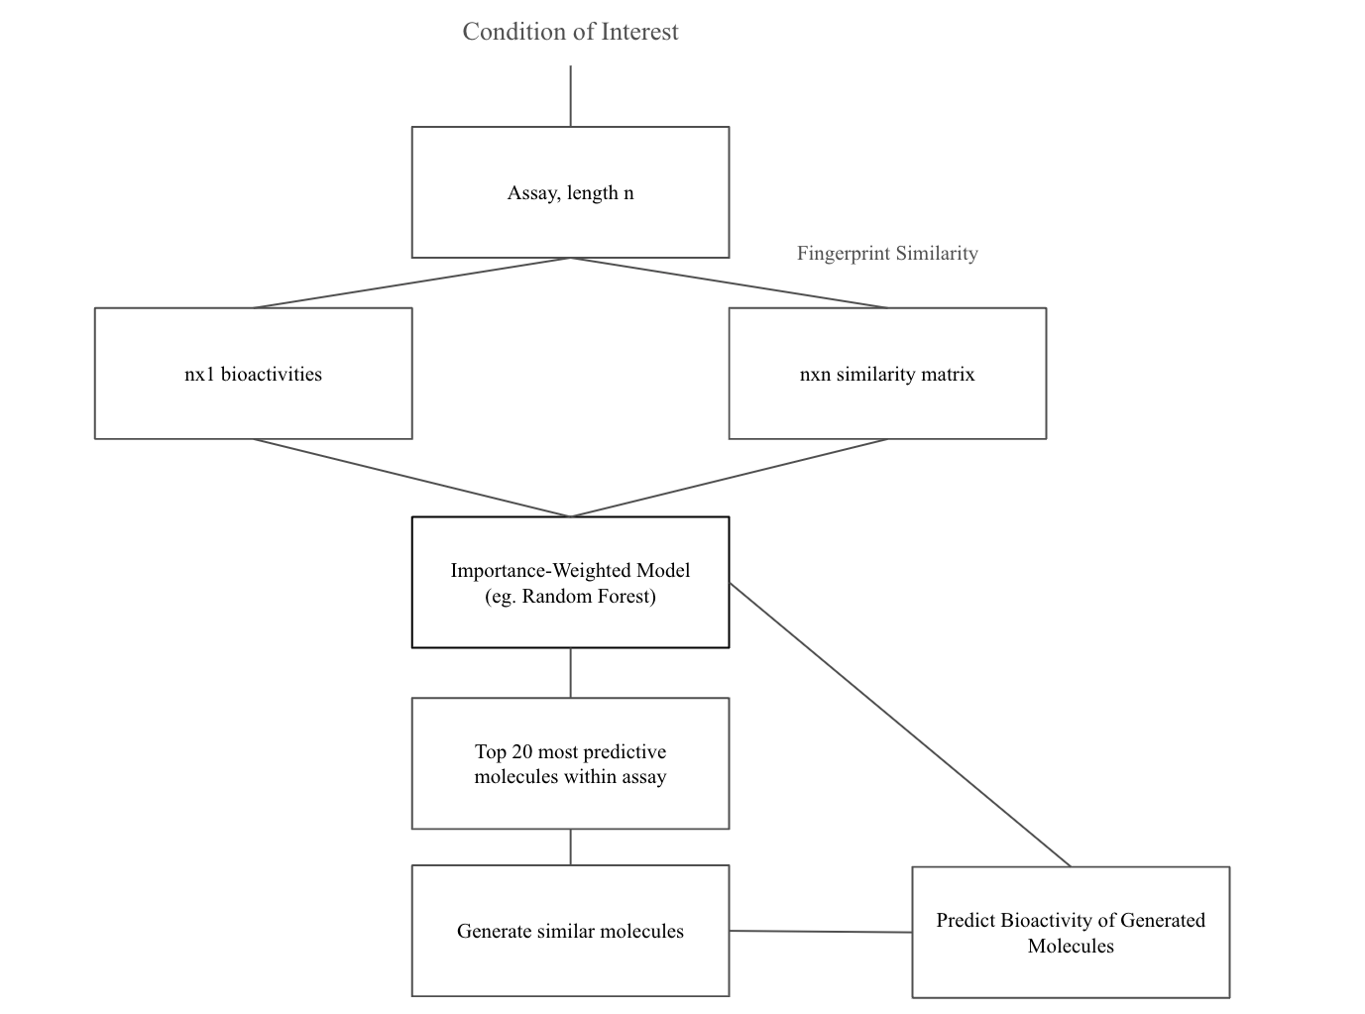

Pipeline Overview: LLM Molecular Candidate Generation a-priori
Austin Yang, Manuel Rivas (Stanford Department of Biomedical Data Science)

Slide 3
Why this pipeline?
Tldr: It’s results are promising ☺
We generate promising molecular candidates without having to fine-tune a standard transformer model (which takes time!)
Target of interest, input assay, and feature to optimize are all adjustable

Slide 4
Two possible options for MimicMol
a)
Consumer: Interested in a target
b)
Consumer: Provides target AND assay
Obtain assay data from molecular data providers
Run pipeline
Run pipeline
Output generated molecular candidates
Output generated molecular candidates
Provide Synthesization Steps for Molecular Candidates
Provide Synthesization Steps for Molecular Candidates
(Can either be a part of MimicMol or its own idea!)

Slide 5
What I’m unsure about
Pricing
What is an effective pricing strategy (ex. Charge per project / target or make pipeline a subscription service?)
How should we price our product to optimize profits and accessibility to research groups, small biopharma companies, etc.
Platform Development
What should a platform for a product like this look like? How would we build it?
Finding a co-founder
What is the best way to find a good co-founder?

